Slide 1
CCNA 200-301
DHCP Snooping and ARP Inspection

Slide 2
Objectives
Configure Layer 2 security features (DHCP snooping, dynamic ARP inspection, and port security)

Slide 3
DHCP Snooping
Acts like a firewall or an ACL in many ways
Watches for incoming messages on either all ports or some ports
Looks for DHCP messages and ignores all non-DHCP messages
DHCP snooping logic: allow the message or discard the message
Acts off the concept of trusted and untrusted ports for determining which DHCP messages are allowed

Slide 4
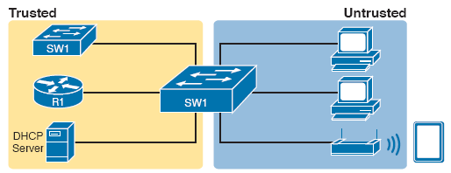
DHCP Snooping Basics: Client Ports are Untrusted

Slide 5
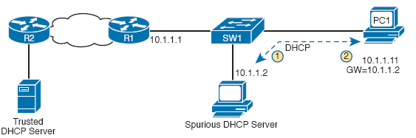
DHCP Attack Supplies Good IP Address but Wrong Default Gateway

Slide 6
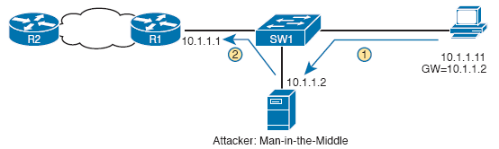
Unfortunate Result: DHCP Attack Leads to Man-in-the-Middle

Slide 7
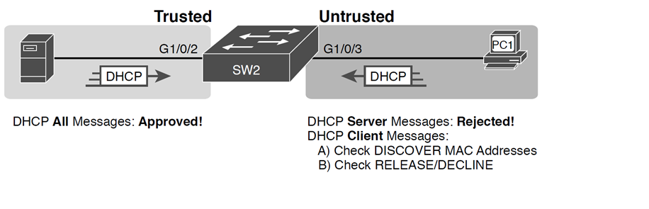
Summary of Rules for DHCP Snooping

Slide 8
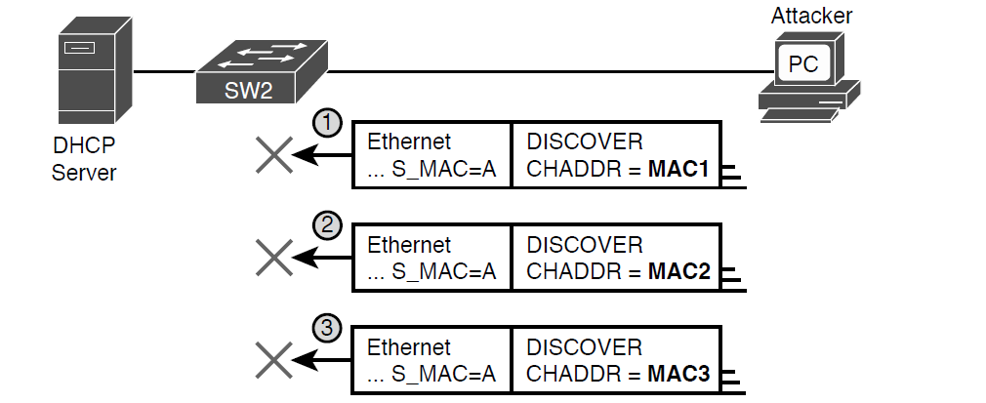
DHCP Snooping Checks chaddr and Ethernet Source MAC

Slide 9
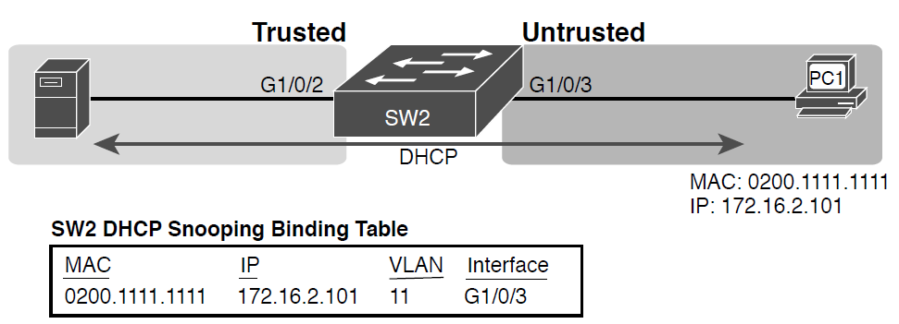
Legitimate DHCP Client with DHCP Binding Entry Built by DHCP Snooping

Slide 10
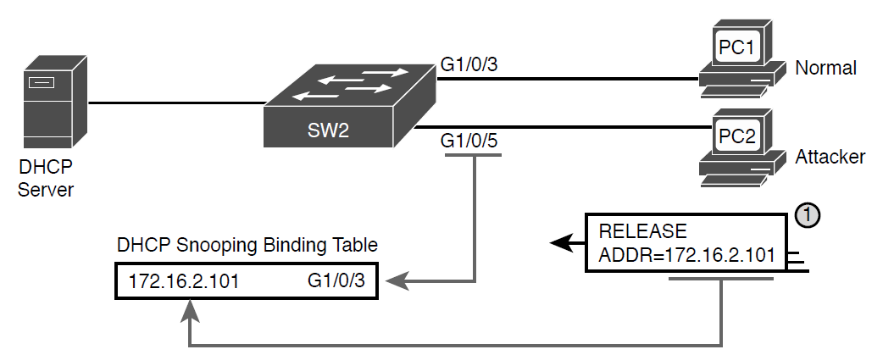
DHCP Snooping Defeats a DHCP RELEASE from Another Port

Slide 11
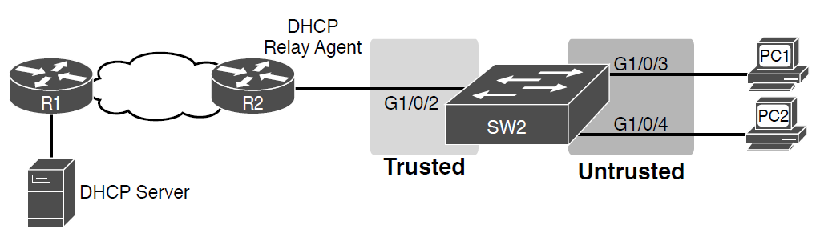
Sample Network Used in DHCP Snooping Configuration Examples

Slide 12
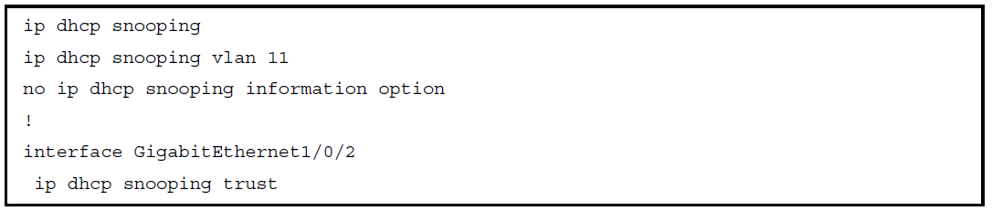
DHCP Snooping Configuration to Match Previous Graphic

Slide 13
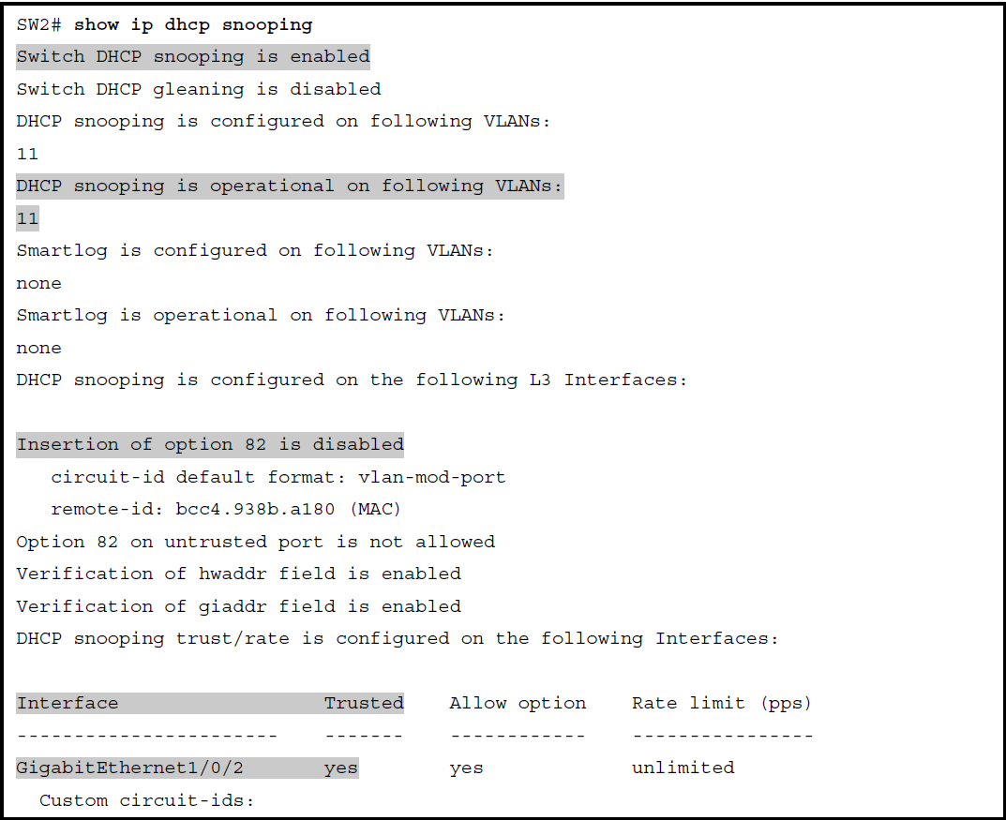
SW2 DHCP Snooping Status

Slide 14
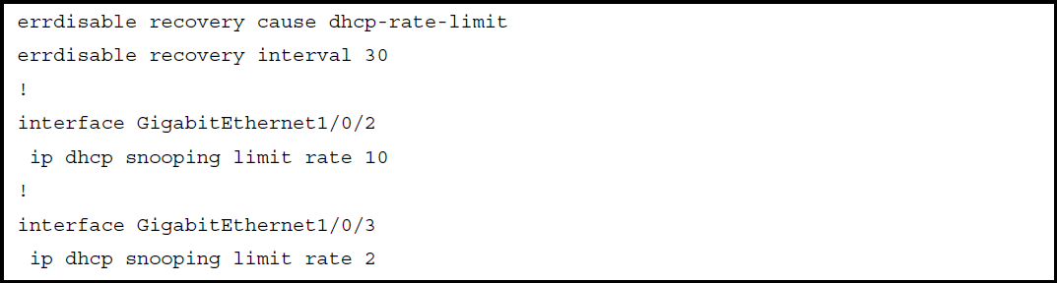
Configuring DHCP Snooping Message Rate Limits

Slide 15
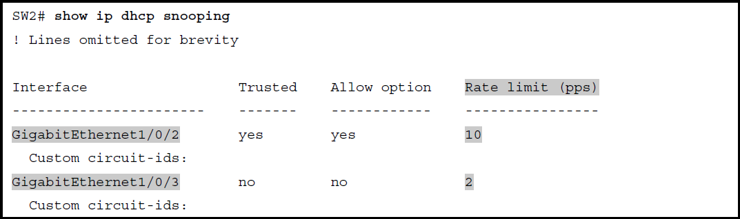
Confirming DHCP Snooping Rate Limits

Slide 16
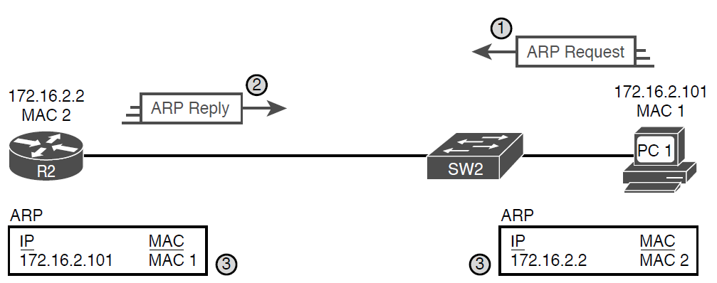
Legitimate ARP Tables After PC1 DHCP and ARP with Router R2

Slide 17
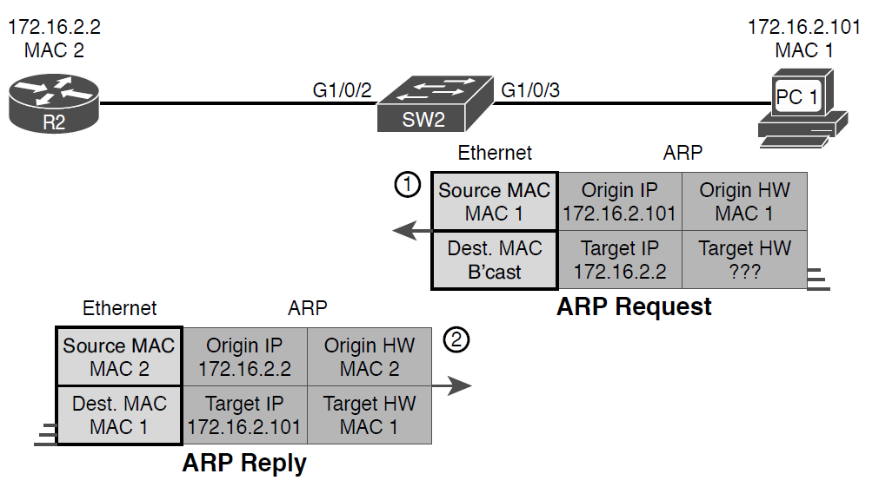
A Detailed Look at ARP Request and Reply

Slide 18
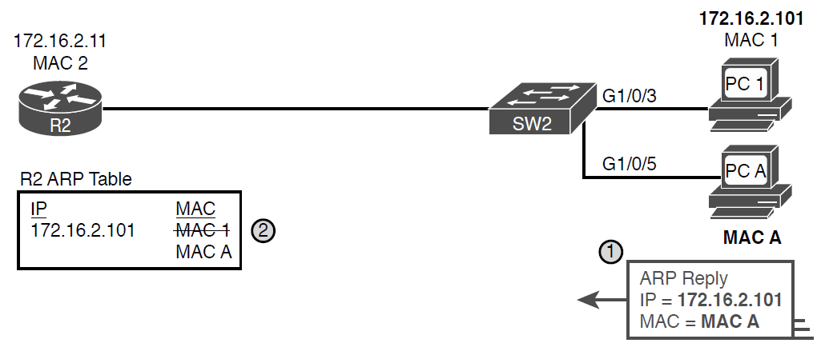
Nefarious Use of ARP Reply Causes Incorrect ARP Data on R2

Slide 19
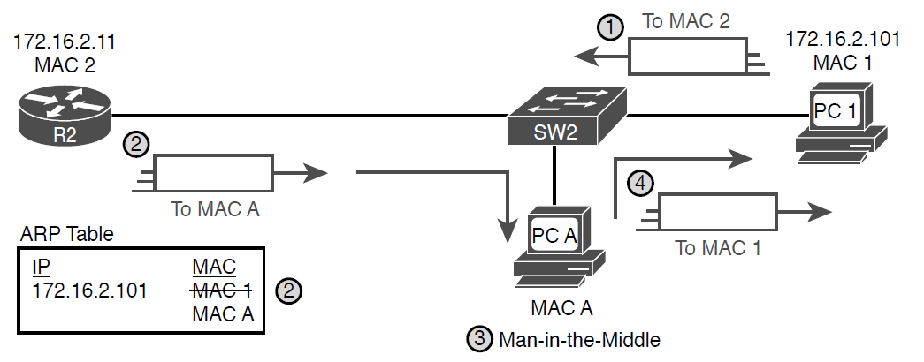
Man-in-the-Middle Attack Resulting from Gratuitous ARP

Slide 20
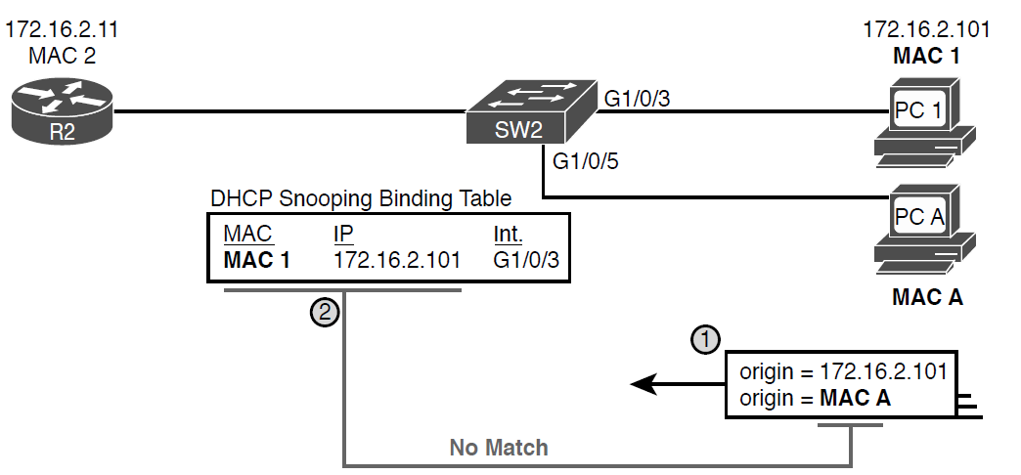
DAI Filtering ARP Based on DHCP Snooping Binding Table

Slide 21
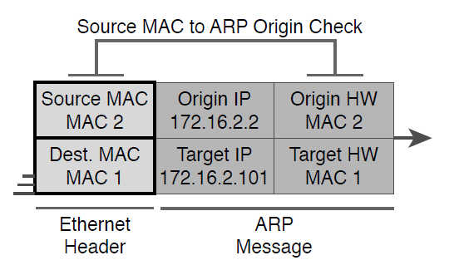
DAI Filtering Checks for Source MAC Addresses

Slide 22
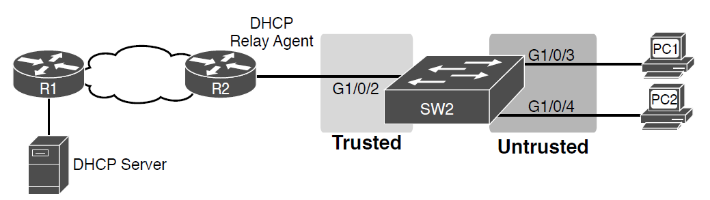
Sample Network Used in ARP Inspection Configuration Examples

Slide 23
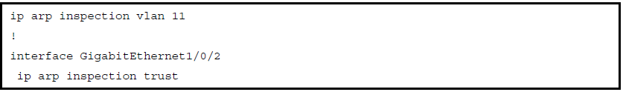
IP ARP Inspection Configuration to Match Previous Graphic

Slide 24
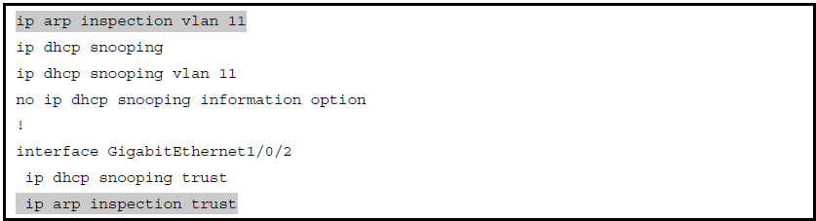
IP DHCP Snooping Configuration Added to Support DAI

Slide 25
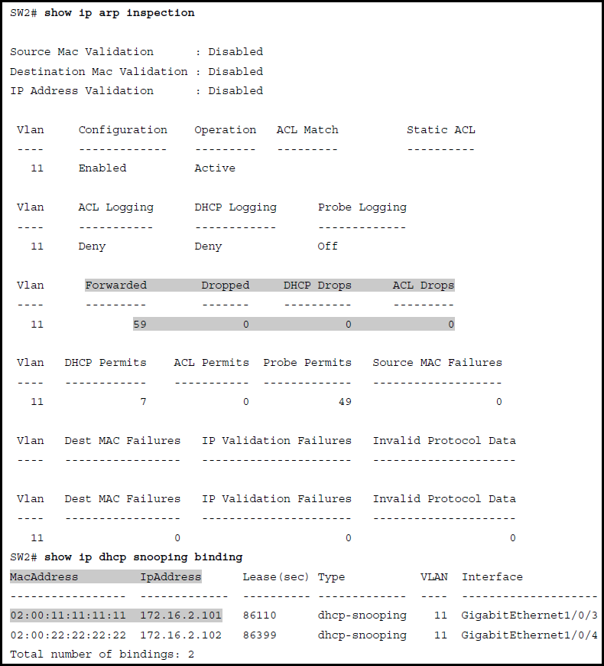
SW2 IP ARP Inspection Status

Slide 26
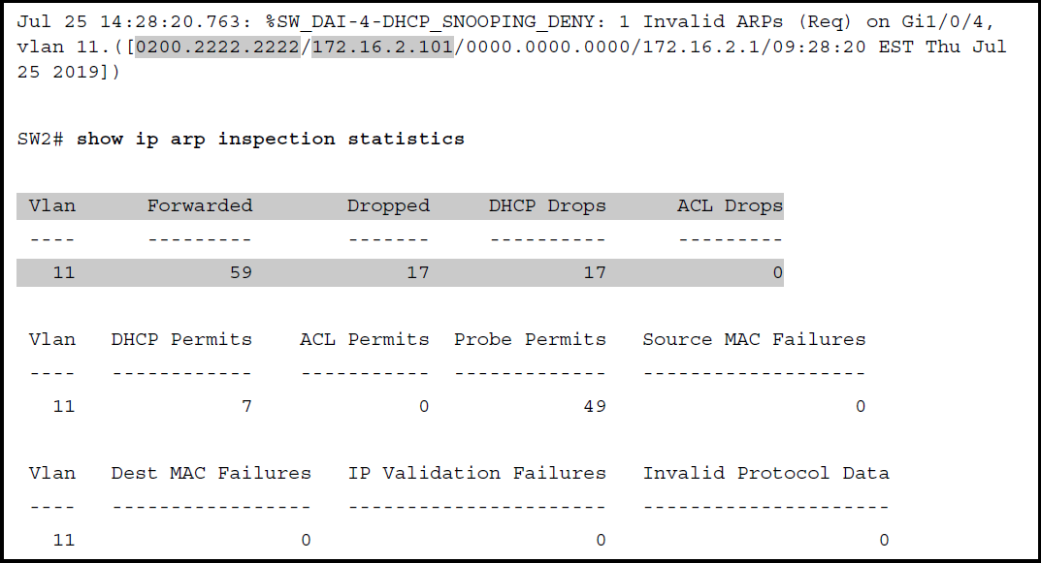
Sample Results from an ARP Attack

Slide 27
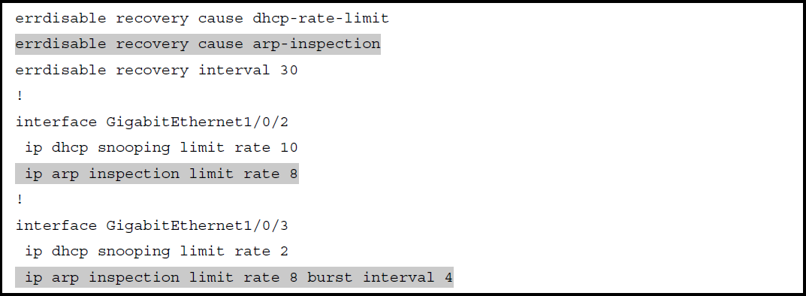
Configuring ARP Inspection Message Rate Limits

Slide 28
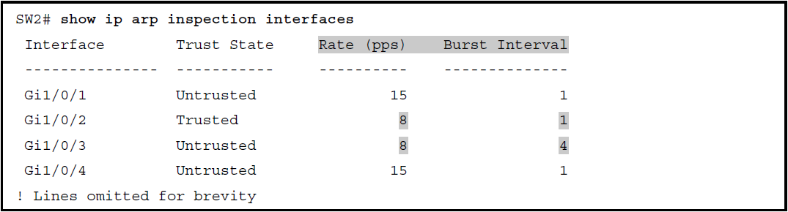
Confirming ARP Inspection Rate Limits

Slide 29
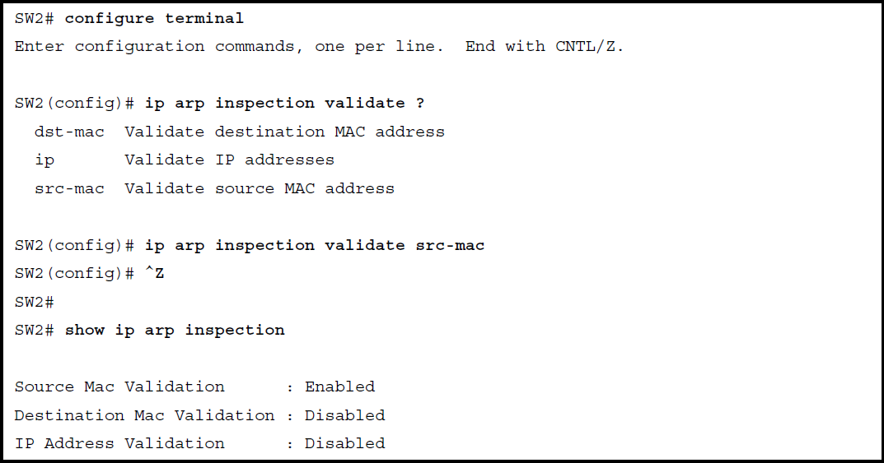
Configuring Optional DAI Message Checks

